Slide 1
Crack measurement
Sk Mamud Haque [ neural model and tensorflow]
Aditya Parihar [ android app]
Under the guidance of
Prof. Priya Ranjan
UPES

Slide 2
Procedure
load rgb image of surface
contrast stretch
convert rgb to grayscale
image segmentation
morphological operations (thin, clean , fill, etc...)
imtool for pixel length determination
Calculation of crack length based on calibration of image and above determined pixel length.
crack_length=(crack_pixel *calibration_length)/calibration_pixels;

Slide 3
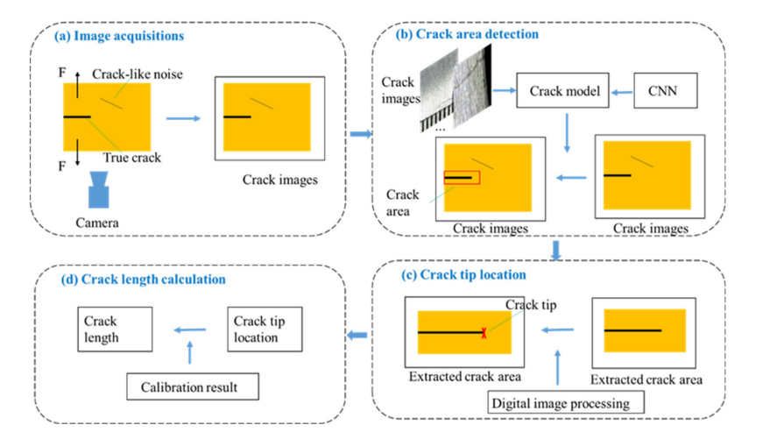

Slide 4
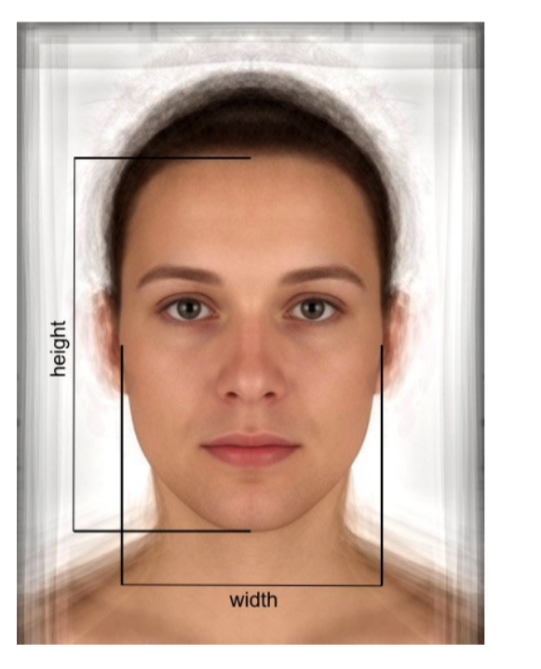
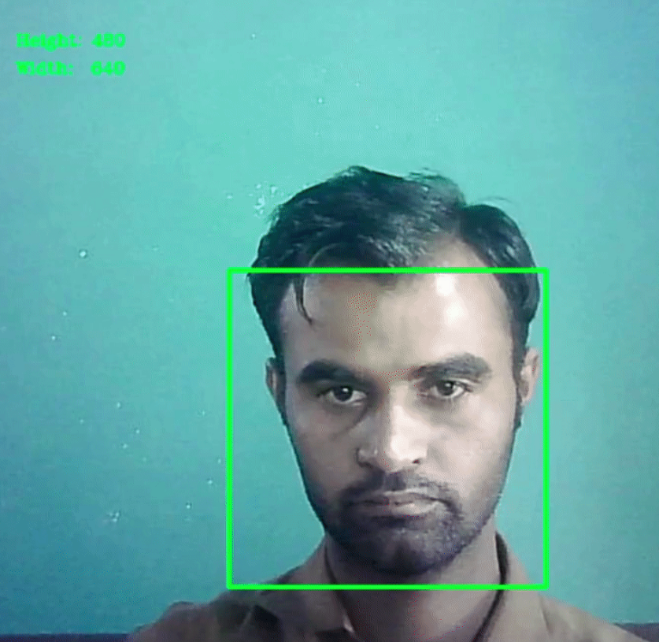
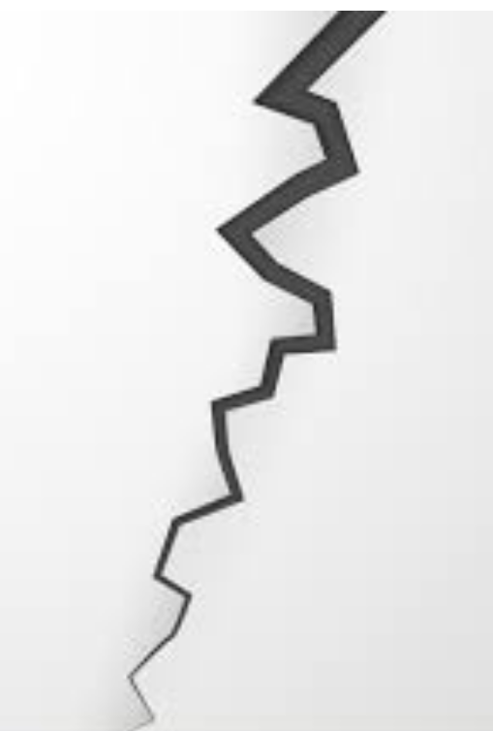

Slide 5
Future Work
Build model and deploy in tensorflow
Download file for android
Setup in the app

Slide 6

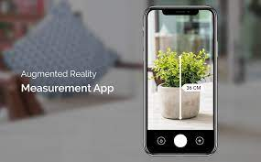
Method of Development
Machine Learning
Augmented Reality

Slide 7
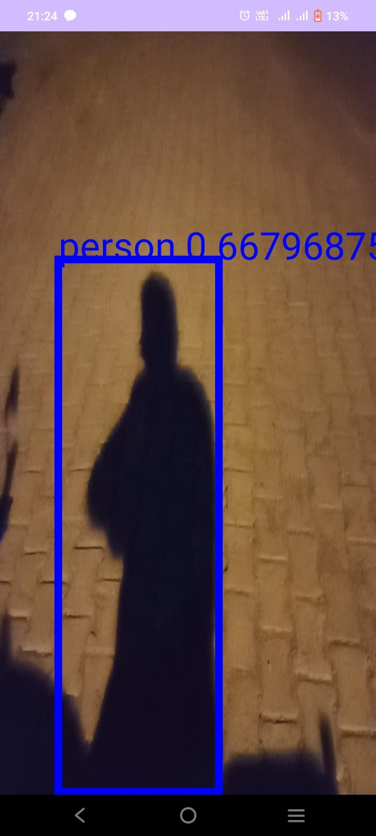
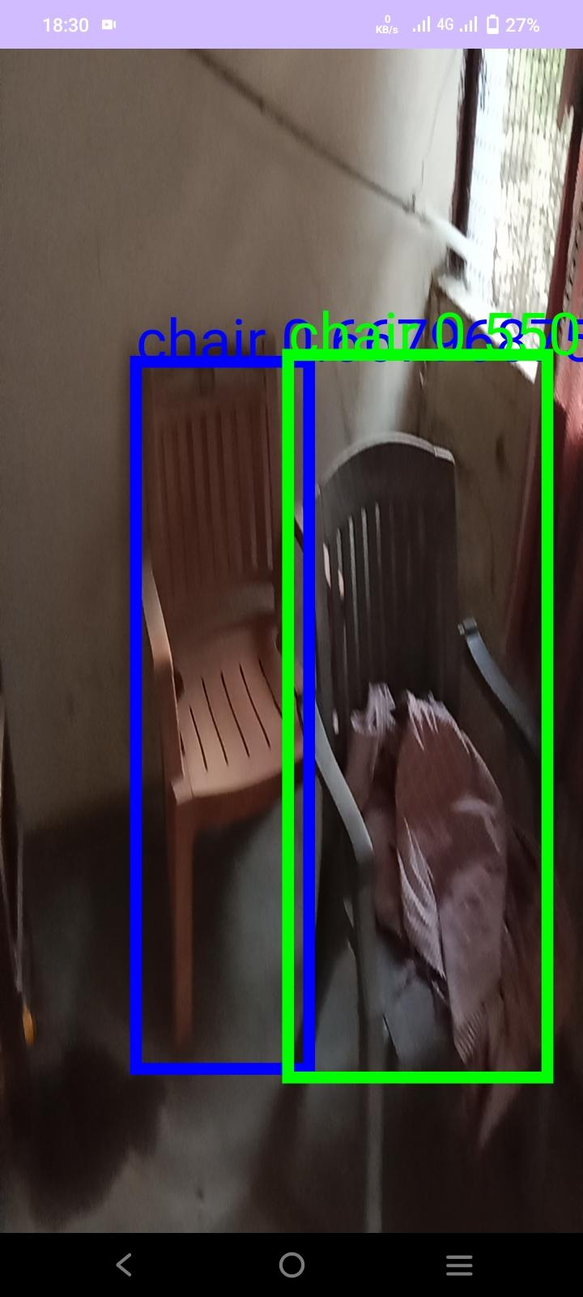
Current Status - Object Detection

Slide 8
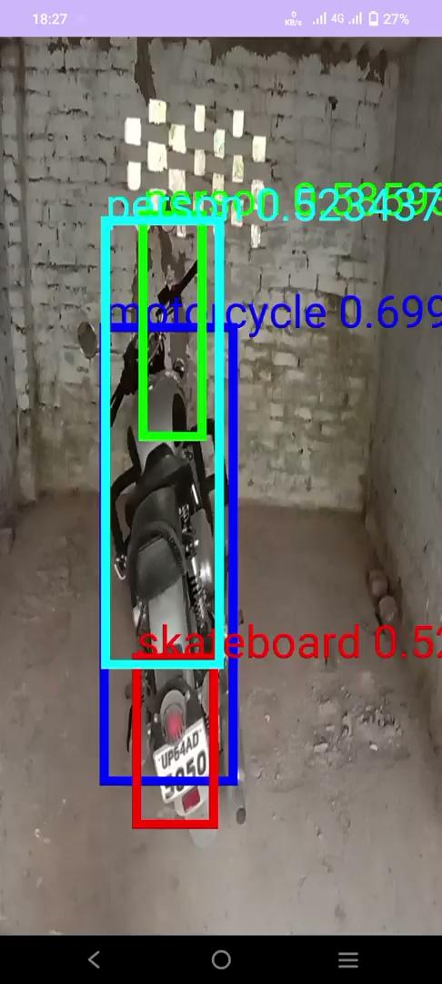

Slide 9
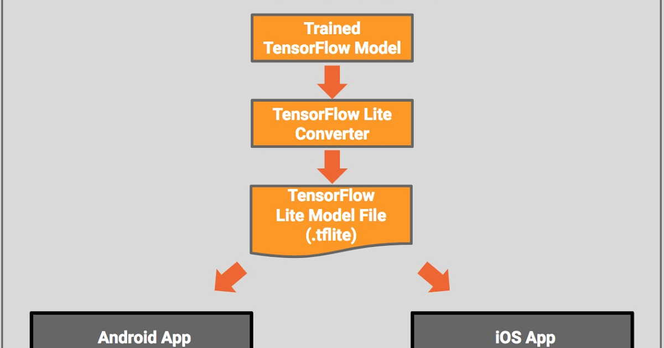
Working
FlatBuffer is Used

Slide 10
Future Work
Custom ML model as per requirement
Distance Measurement
Crack analysis

